Slide 1
Big Data Graduation Project
Presented By: YOUSSEF ALAA MOHAMED EL-Raqabawy

Slide 2
Agenda
INGESTION
Storage
Processing & Analysis
Output file
Visualization
Oozie Workflow

Slide 3
INGESTION
Firstly, we load our data from our local machine to our virtual machine by selecting the data (dataset file) from the local machine, copy it and paste it on our virtual machine which is ( VMware Workstation pro 15.5).

Slide 4
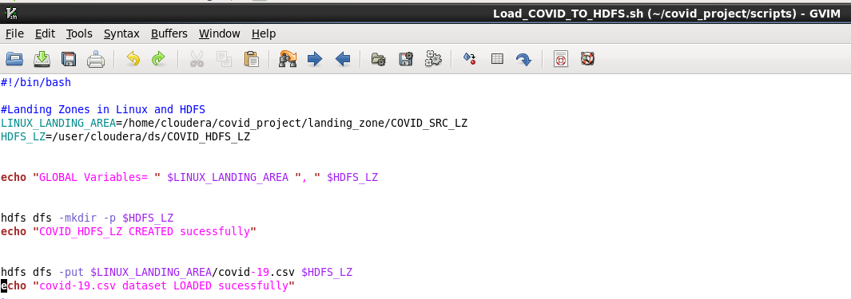
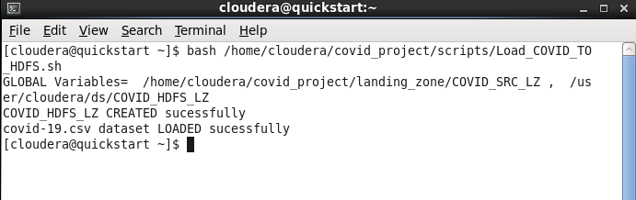
Storage
We load the data on the system which is HDFS, by creating a directory where we will put the dataset file and then load it into HDFS.

Slide 5
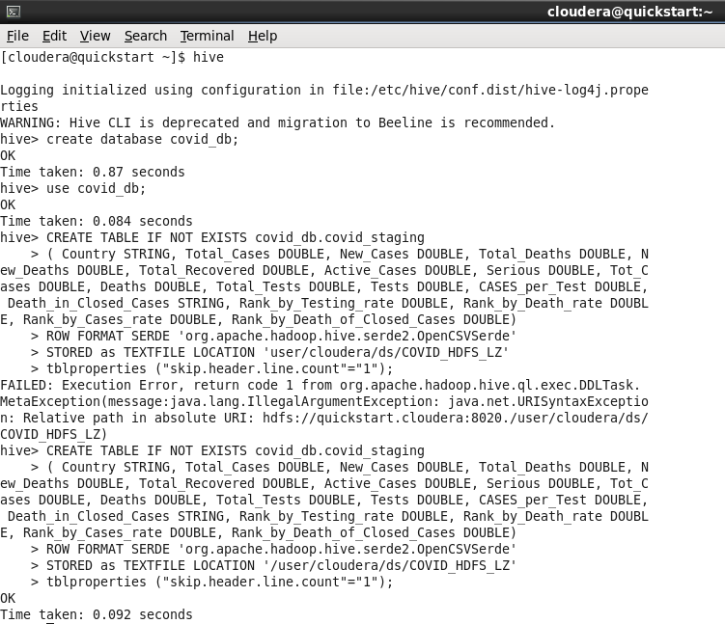
Processing & Analysis
We create a database to store the data in it, then we load the data from the csv file to our first table, then we partition the data into another table to sort it by country to make the queries faster.

Slide 6
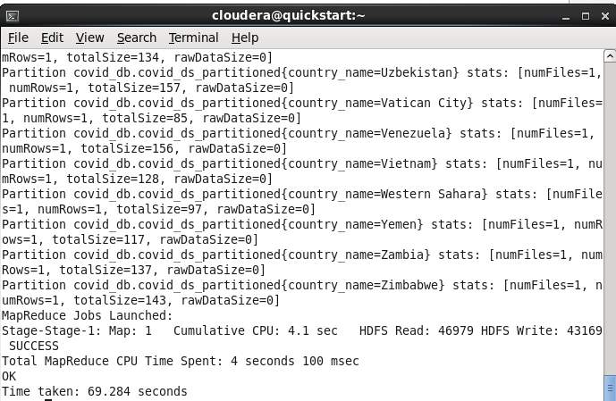
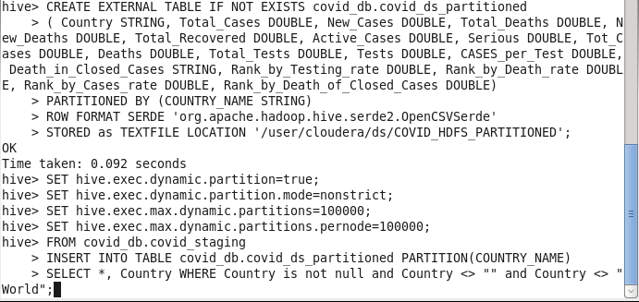
Processing & Analysis

Slide 7
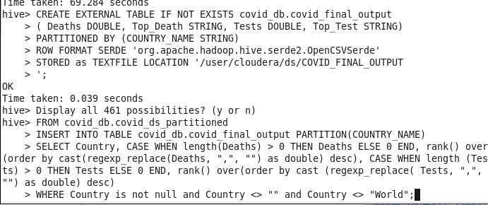
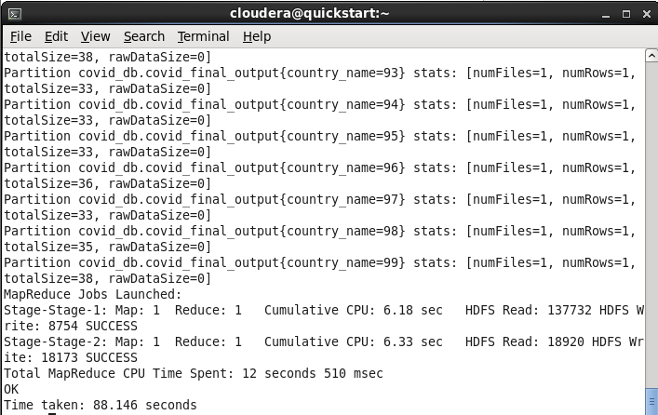
Processing & Analysis
We created the output table and fill it with some data in the other table, where the rank function is used to sort the countries according to tests and deaths.

Slide 8
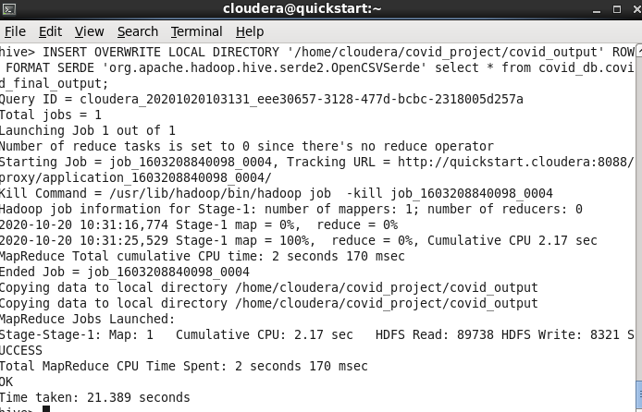
Output file
We export the output table in csv file with the commands shown in the screenshot.

Slide 9
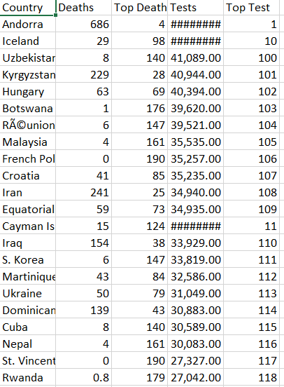
Output file
Part of the csv output file.

Slide 10
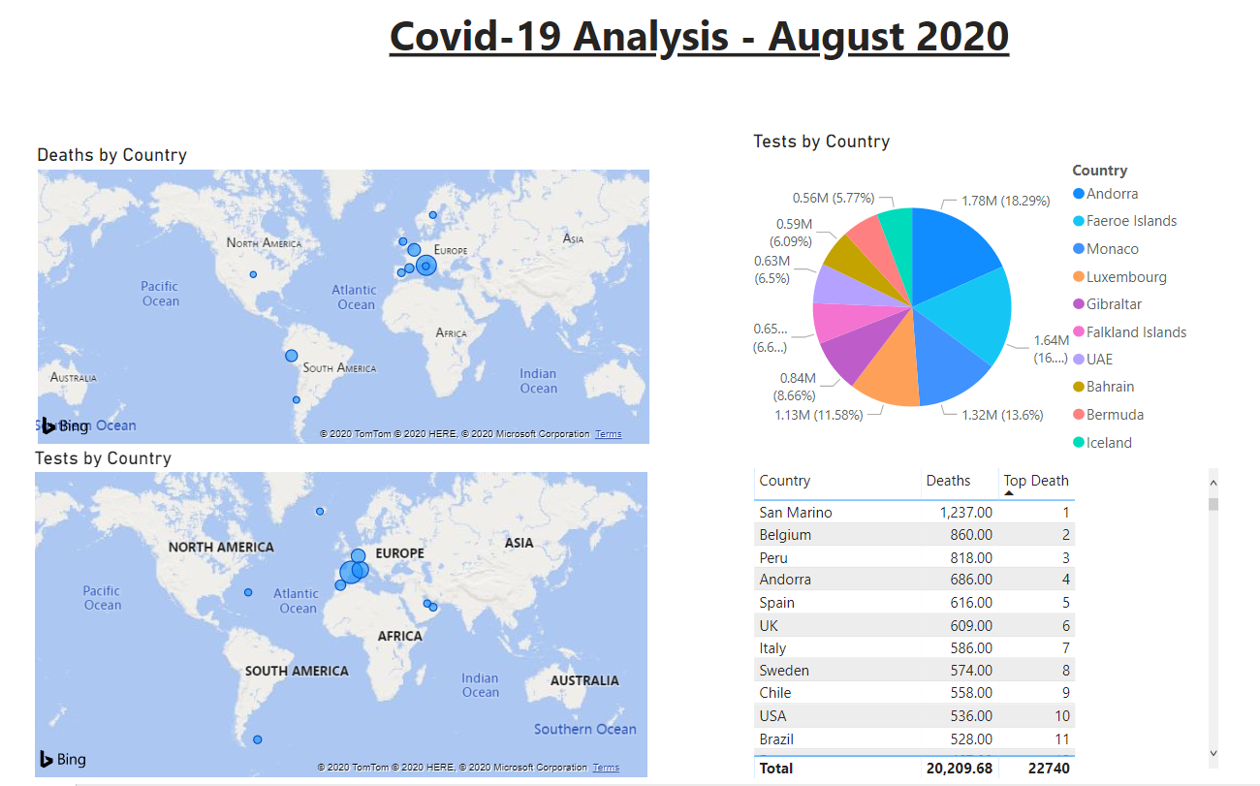
Visualization
We use the csv output file to
visualize the data by using the
Power Bi tool, where we can
see the top 10 in death rate
and in tests rate on the map.

Slide 11
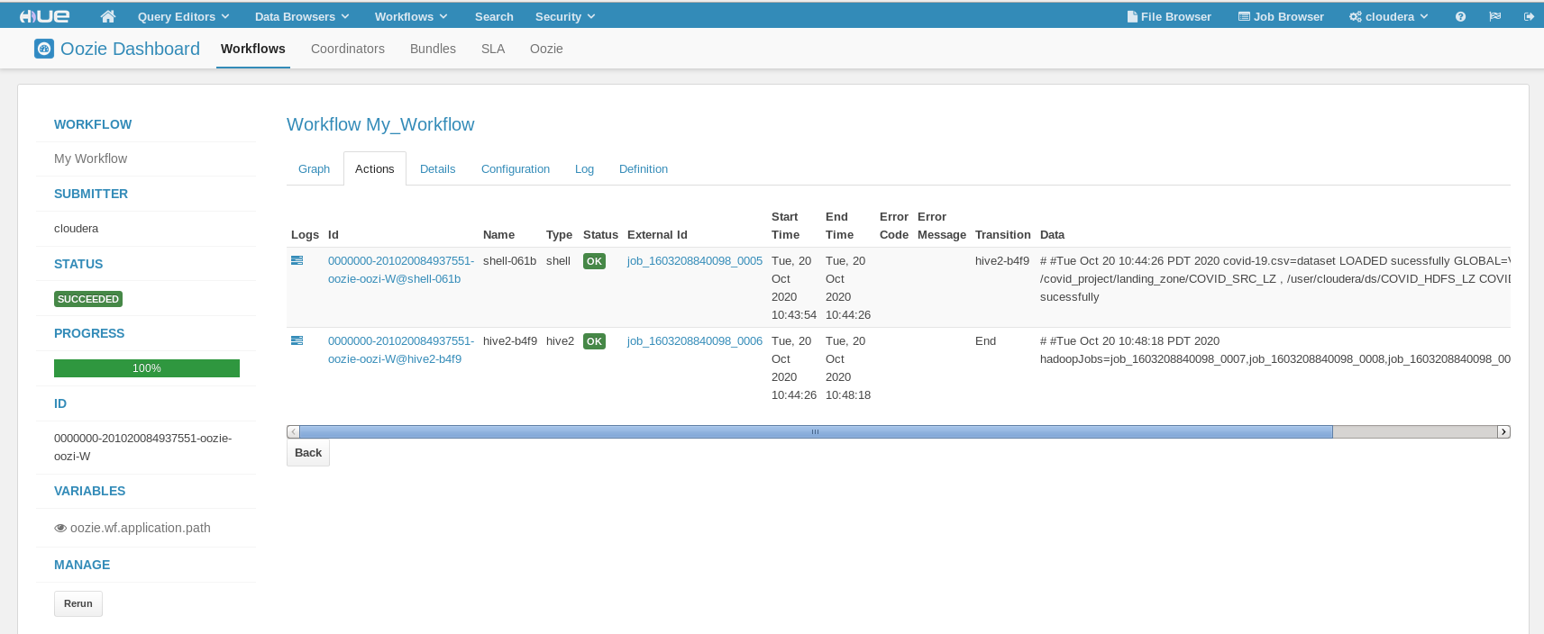
Oozie Workflow
We use Oozie to automatically run the HDFS and hive scripts as a workflow.

